Slide 1
PART III
PRINCIPLES OF ELECTRONIC COMMUNICATION

Slide 2
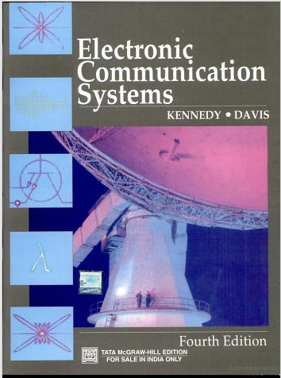
Chapter 7
Fundamentals of Analog Communication
Reference:
Electronic Communication Systems by
Kennedy & Davis ,
4th edition,2004,TMH Edition
Notes:
Communication is the process of transferring of information from one point to another by electronic means.
Based on the type of the signal transmitted, communication can be of analog or digital.
The analog communication involves transmitting of an analog signal such as music, video etc. from source to destination.

Slide 3
Module 1 Amplitude Modulation
OBJECTIVES:
Explain the principle of electronic communication using a block diagram.
Define modulation and discuss the need for modulation.
Explain amplitude modulation using suitable waveforms, define modulation index and draw the spectrum
Derive expression for power content of AM signal.
List and describe different types of AM signal and compare them.
Explain the principle of AM demodulation process and super heterodyne receiver.

Slide 4
Introduction
What is Communication?
What are different methods of Communication?
Refer history for more details
Notes:
Communication is defined as the process of transfer of information from one place to another.
In general, communication can be either face to face or may be exchange of signals, text or it can takes place through electronic means such as telegraph, telephone, radio, TV, internet etc.

Slide 5

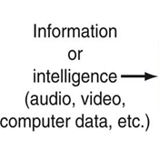


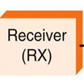


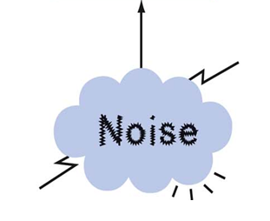
Basic Communication System
Fig.1.1 General model of a communication system
Basic Components:
Transmitter
Channel or Medium
Receiver
Refer:Introduction.docx
Notes:
Information Source: Information can be continuous such as speech, music, picture etc. It consists of Input transducer to convert the physical quantity (non-electrical) to electrical signal.
Transmitter: Consists of filters, amplifiers, modulator. Filter is used to eliminate the unwanted signal coming from the transducer. The signal is amplified to the required level using amplifier. The modulator translates the message signal/ baseband signal from low frequency to a high frequency to make it suitable for the transmission over the channel .
Transmission channel: It is a medium over which the electronic signal is transmitted from source to the destination. It can be wired or wireless. Examples for wired communication are: twisted pair cables used in telephony, coaxial cables used in cable TV transmission, waveguides, optical fiber cables. Examples for wireless communication are: air/open space and sea water.
Noise: It is a random, undesirable electrical energy that interferes with the transmitted signal. It can be internal/external.
Receiver: It consists of receiving antenna, filter, demodulator and amplifier. The signal received from receiving antenna is filtered and desired signal is amplified. It is further demodulated to get back the original transmitted signal. Output transducer is used to convert back the information in electrical form to physical form.
Communication can be Simplex (Radio, TV broadcasting), Half Duplex (Police/ military radio transmission) or Full Duplex (Telephones, Internet)
Based on type of data transmitted communication can be Analog (TV) or Digital (Computers, Cell-phones)

Slide 6
Self Test
In a communication system, noise is most likely to affect the signal
a) At the transmitter
b) In the channel
c) In the information source
d) At the destination

Slide 7
Modulation
What is Modulation?
Why modulation is necessary?
To enable long distance communication
To reduce the height of the antenna
For multiplexing
To combat noise
Refer: Need for modulation.docx
Notes:
Modulation is the process of impressing information onto a high-frequency carrier, in order to make it suitable for transmission.
Modulation is defined as the systematic alteration of one waveform called the carrier, according to the characteristic of another waveform i.e. the modulating signal or the message signal. We use c (t ) and m(t ), to denote the carrier and the message waveforms respectively.
The three parameters of a sinusoidal carrier that can be varied are: amplitude, phase and frequency. A given modulation scheme can result in the variation of one or more of these parameters.
Need for modulation:
The height of the antenna required to transmit and receive the low frequency signals is impractical and hence modulation is needed
Modulation increases the frequency of the signal to be radiated and thus increases the distance over which signal can be transmitted faithfully.
Multiplexing allows transmission of two or more information signals simultaneously over a single channel and thus allows several users to use the single channel

Slide 8




Analog Modulation

Slide 9
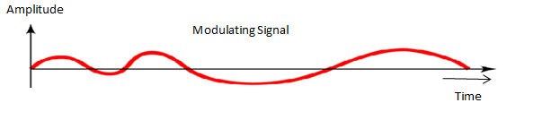
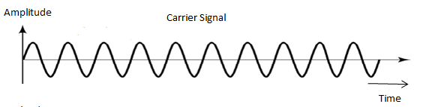
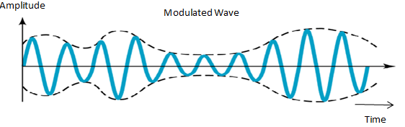
Amplitude Modulation
What is AM?
Graphical Representation:
Notes:
Amplitude Modulation is a process of varying the amplitude of a carrier signal in accordance with the message signal.
The frequency of the carrier signal is usually much greater than the highest frequency of the input message signal.
The modulating signal is multi-tone in nature, having several frequency components in it.

Slide 10
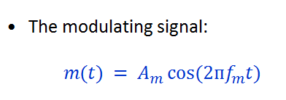
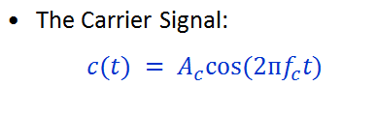
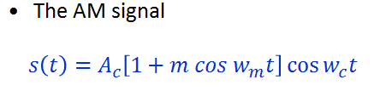
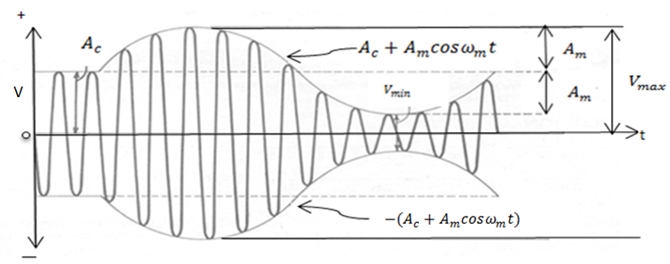
Representation of AM for Single-tone modulation
Refer:Description of AM wave.docx
Notes:
Where ‘$m$’ is the modulation index of AM signal, which is defined as ratio of amplitude of modulating signal to that of carrier signal

Slide 11
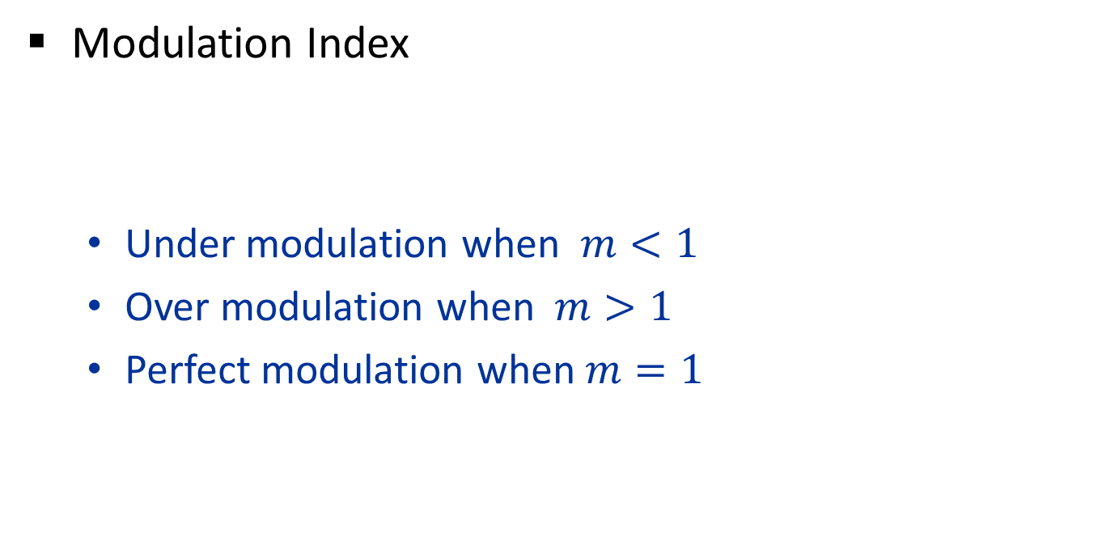
Modulation Index for AM wave
Modulation Index
Under modulation when $m<1$
Over modulation when $m>1$
Perfect modulation when $m=1$
Notes:
The significance of modulation index is, it decides the depth of modulation.
If it is less than one, then AM signal is known as under modulated signal.
If it is more than one, then AM signal is known as over modulated signal.
If it is equal to one, then AM signal is known as perfect modulated signal.
To obtain the original information, modulation index should always be less than or equal to one.

Slide 12
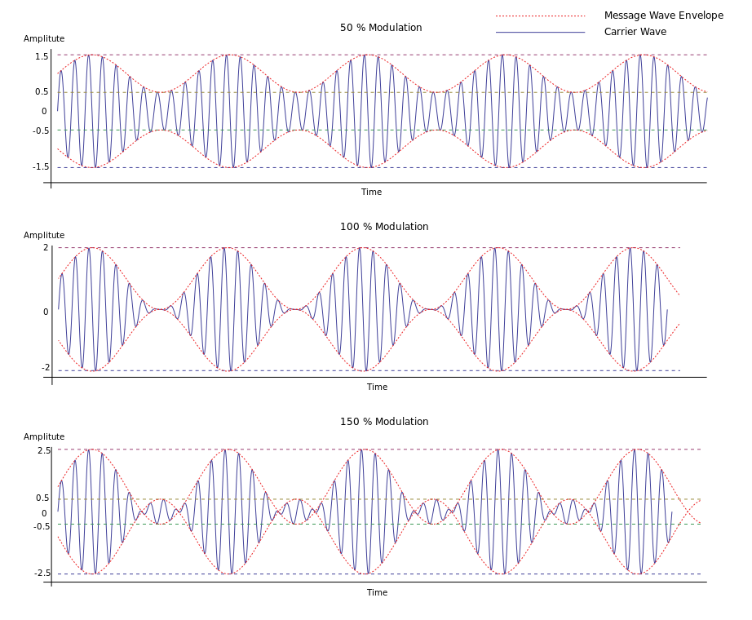



Effect of modulation index on AM wave
$$m=0.5$$
$$m=1$$
$$m=1.5$$
Notes:
Under modulation if m<1
Over modulation if m>1
Perfect modulation if m=1
To obtain the original information, modulation index should always be less than or equal to one.

Slide 13
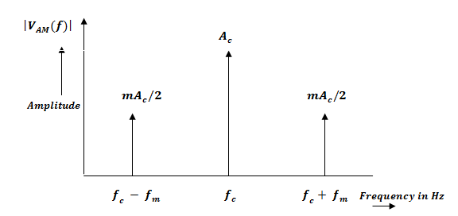
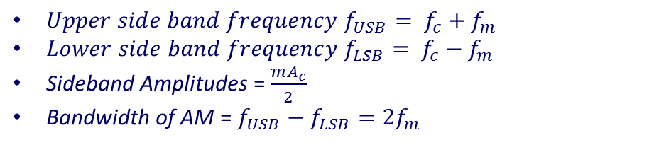
Spectrum of AM wave
$V_{AM}\left(t\right)$ = $A_{c}\cos\left(2πf_{c}t\right)+\frac{mA_{c}}{2}\left\{\cos\left[2π{(f}_{c}+f_{m})t\right]+\cos\left[2π{(f}_{c}−f_{m})t\right]\right\}$
${Upper side band frequency f}_{USB}= f_{c}+f_{m}$
${Lower side band frequency f}_{LSB}= f_{c}−f_{m}$
Sideband Amplitudes = $\frac{mA_{c}}{2}$
Bandwidth of AM = $f_{USB}−f_{LSB}=2f_{m}$
Refer :Spectrum of AM.docx
Notes:
The spectrum of AM consists of three frequency components, one at fc and other two at f_{c}+ f_{m} , f_{c}- f_{m}.
The frequencies f_{c}+ f_{m} and f_{c}- f_{m} are known as sideband frequencies.
f_{c}+ f_{m} is known as upper sideband frequency
f_{c}- f_{m}is known as lower sideband frequency .
The separation between these two frequencies is defined as bandwidth of AM signal.
Therefore the bandwidth of AM signal is 2f_{m}.

Slide 14

Power and Current in AM Wave
Power in AM wave
$PT = P_{C} +P_{TSB}$
$For m=1$
$PC = 66.66\% PT$
AM Current
$IT = I_{C}\{ 1 + (m2/2) \}0.5$
Refer: Power in AM wave.docx
Notes:
The total power required to transmit AM signal ( P_{T} ) is sum of power required to transmit carrier signal ( P_{C} ) and power required to transmit side band signals($P_{TSB}$)
P_{T} = P_{C} + P_{TSB} = P_{C} { 1 +( m²/2) }
For 100% modulation : m = 1, P_{C} = 66.66%P_{T}
i.e. 66.66% of total power is wasted in transmitting carrier signal.
For current, ‘I_{T}’ is the current with modulation , ‘I_{C}’ is the current without modulation

Slide 15

Modulation by several sine waves
Overall modulation index
$m=(m12 + m22 +…….)0.5$
Total Power
$P_{T}=P_{C}\left\{1+\left(\frac{{m_{t}}^{2}}{2}\right)\right\}$
Total Current
$I_{T}=I_{C}\left\{{\left[1+\left(\frac{{m_{t}}^{2}}{2}\right)\right]}^{0.5}\right\}$
Notes:
Here the carrier is modulated by several sine waves with different modulation indices m1, m2, m3 etc.

Slide 16
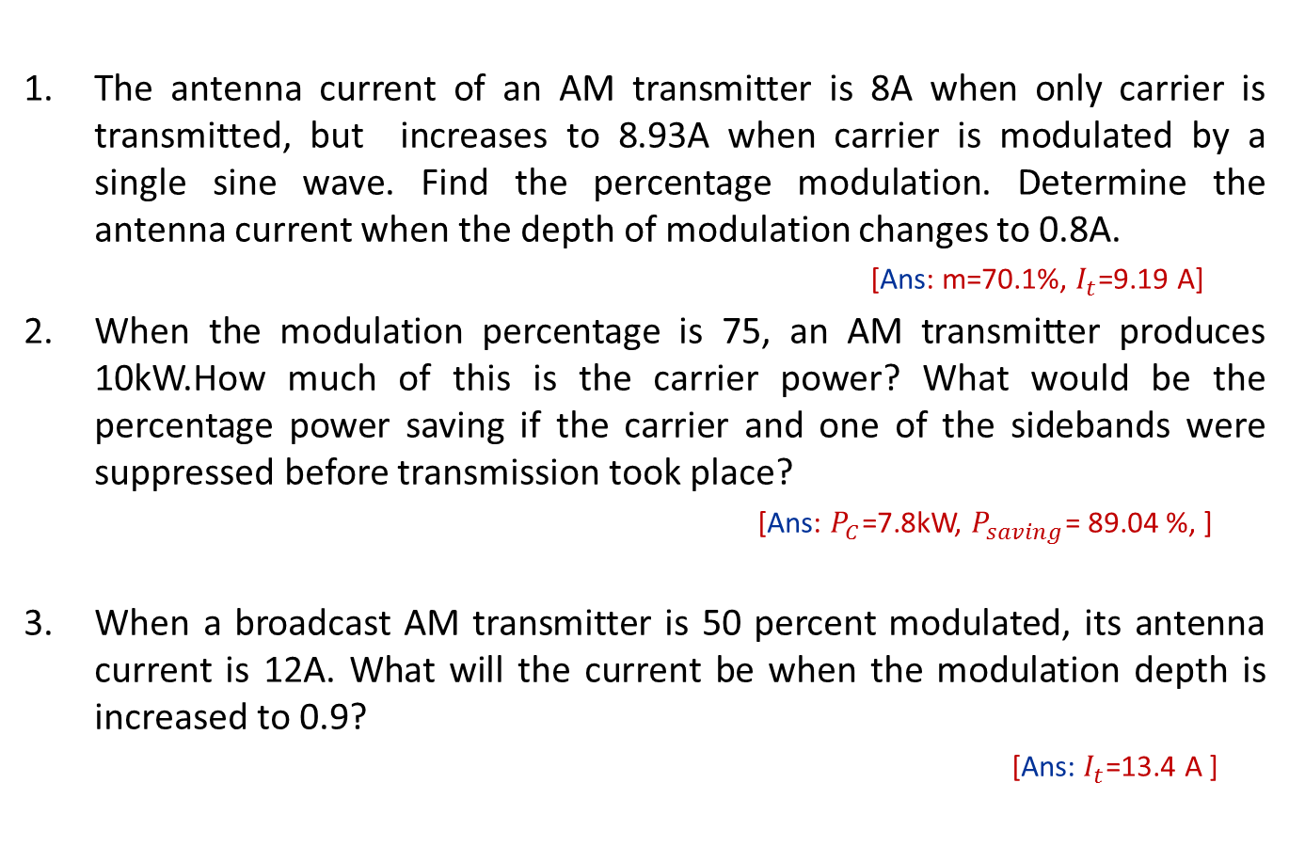
Exercises
The antenna current of an AM transmitter is 8A when only carrier is transmitted, but increases to 8.93A when carrier is modulated by a single sine wave. Find the percentage modulation. Determine the antenna current when the depth of modulation changes to 0.8A.
[Ans: m=70.1%, $I_{t}$=9.19 A]
When the modulation percentage is 75, an AM transmitter produces 10kW.How much of this is the carrier power? What would be the percentage power saving if the carrier and one of the sidebands were suppressed before transmission took place?
[Ans: $P_{C}$=7.8kW, $P_{saving}$= 89.04 %, ]
When a broadcast AM transmitter is 50 percent modulated, its antenna current is 12A. What will the current be when the modulation depth is increased to 0.9?
[Ans: $I_{t}$=13.4 A ]

Slide 17
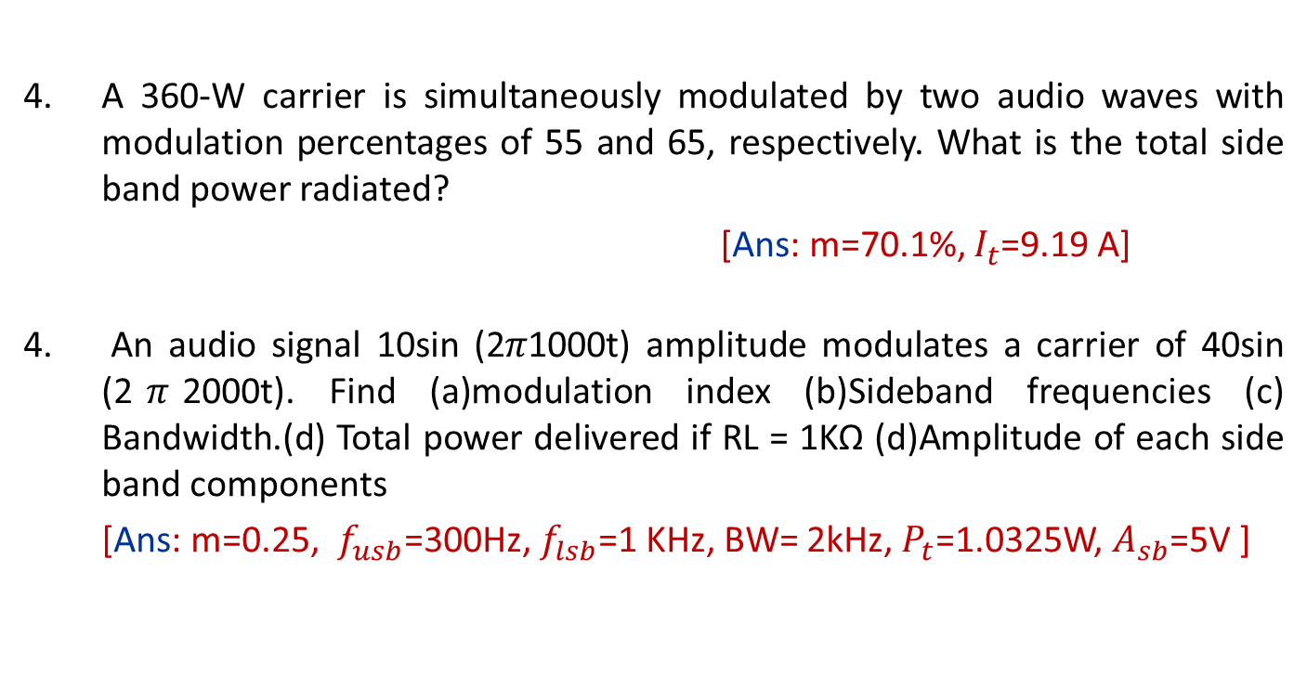
Exercises
A 360-W carrier is simultaneously modulated by two audio waves with modulation percentages of 55 and 65, respectively. What is the total side band power radiated?
[Ans: m=70.1%, $I_{t}$=9.19 A]
An audio signal 10sin (2$π$1000t) amplitude modulates a carrier of 40sin (2$π$2000t). Find (a)modulation index (b)Sideband frequencies (c) Bandwidth.(d) Total power delivered if RL = 1KΩ (d)Amplitude of each side band components
[Ans: m=0.25, $f_{usb}$=300Hz, $f_{lsb}$=1 KHz, BW= 2kHz, $P_{t}$=1.0325W, $A_{sb}$=5V ]

Slide 18
Types of AM
Double Side Band With Carrier (AM-DSB)
Double Side Band-Suppressed Carrier (DSB-SC)
Single Side Band (SSB)
Vestigial Side Band (VSB)
Refer :Types of AM wave.docx
Notes:
DSB-FC Is conventional AM with carrier and 2 side bands.
DSB-SC is obtained by eliminating carrier component.
Disadvantages are: less information about the carrier will be delivered to the receiver, Needs a coherent carrier detector at receiver
SSB-SC is a popular method , where BW is same as that of the modulating signal. suppresses the carrier and one of the sidebands
In VSB AM system, one sideband is completely present, and a part (vestige) of other sideband is retained

Slide 19
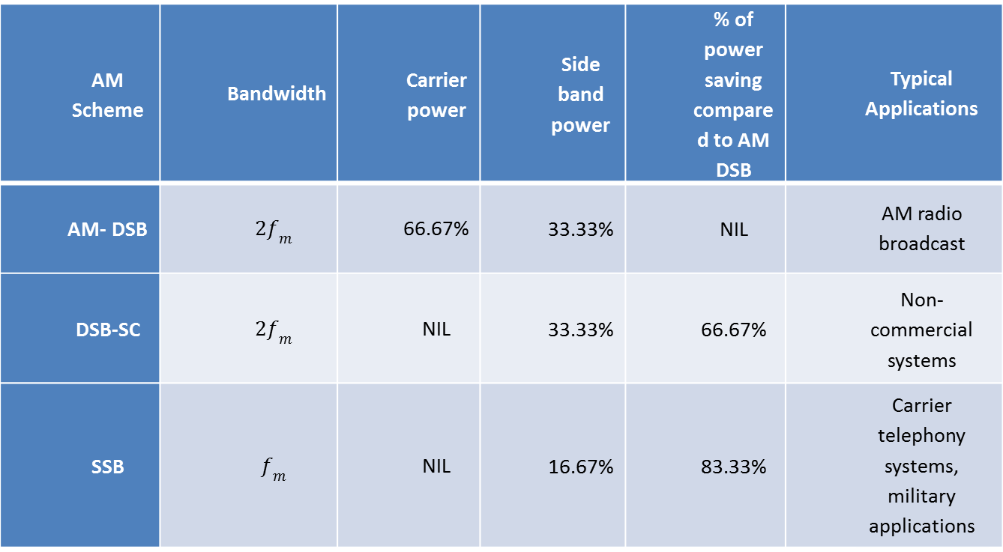
Comparison of different types of AM
AM Scheme | Bandwidth | Carrier power | Side band power | % of power saving compared to AM DSB | Typical Applications
AM- DSB | $$2f_{m}$$ | 66.67% | 33.33% | NIL | AM radio broadcast
DSB-SC | $$2f_{m}$$ | NIL | 33.33% | 66.67% | Non-commercial systems
SSB | $$f_{m}$$ | NIL | 16.67% | 83.33% | Carrier telephony systems, military applications

Slide 20
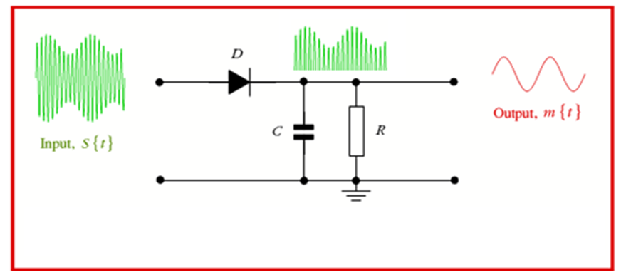
AM Detection
AM Envelope Detector
Notes:
This is essentially a half wave rectifier with filter circuit, which allows only half of the alternating waveform through. The capacitor bypasses the high frequency carrier component and allows low frequency message signal to go to the output. This demodulator is applicable only for AM-DSB and the main advantage of this form of AM demodulator is that it is very simple and cost effective.

Slide 21
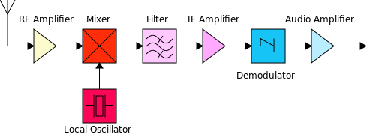
Super heterodyne receiver
Block Diagram:
Refer : Superheterodyne receiver.docx
Notes:
The principle of operation of the superheterodyne receiver depends on the use of heterodyning or frequency mixing. The signal from the antenna is filtered sufficiently at least to reject the image frequency and are amplified. A local oscillator in the receiver produces a sine wave, which mixes with that signal, shifting it to a specific intermediate frequency(IF), usually a lower frequency. The IF signal is itself filtered and amplified and possibly processed in additional ways. The demodulator uses the IF signal rather than the original radio frequency to recreate a copy of the original information (such as audio).

Slide 22
Self Test
1) If the carrier of a 100 percent modulated AM DSB wave is suppressed, the percentage power saving will be
50 b)150 c)100 d) 66.66
2) The modulation index of an AM –DSB wave is changed from 0 to 1. The transmitted power is
Unchanged b) Halved c) Doubled d) Increased by 50 percent
3) A carrier is simultaneously modulated by two sine waves with modulation indices of 0.3 and 0.4 . The total modulation index
a)Is 1 b) Cannot be calculated unless the phase relations are known
c) Is 0.5 d) Is 0.7
4) Amplitude modulation is preferred for broadcasting because
a) It is more noise immune than other modulation systems
b) Compared with other systems it requires less transmitting power
c) Its use avoids receiver complexity
d) No other modulation system can provide the necessary bandwidth for high fidelity
5) What is the ratio of modulating power to total power at 100 percent modulation in AM-DSB?
a) 1:3 b)1:2 c) 2:3 d)None of the above

Slide 23
Summary
In this module we have learnt:
Basic principle of electronic communication
Definition of modulation
Need for modulation
To draw the waveforms for amplitude modulated signal
Modulation index and its significance
Draw the spectrum of AM DSB signal
The power and bandwidth of AM
The different types of AM signal : AM DSB , DSB SC, SSB SC and VSB
Demodulation of AM wave
Working principle of super-heterodyne receiver

